Slide 1
SENTIMENT ANALYSIS FOR MOVIE REVIEW USING NAIVE-BAYES
Tushar Gwal | Vandan Vaishya

Slide 2
DATA SET INFORMATION
Samples | 50,000 movie reviews
Labels | 2 (Positive, Negative)
Training/Test Split | Varies based on user-defined percentage Commonly, 80% training / 20% testing or 70% training / 30% testing
Challenges | Slang, misspellings, and informal language
Preprocessing Needs | Removing HTML tags and non-textual information Standardizing the text to lower case Tokenizing the text and removing stop words

Slide 3
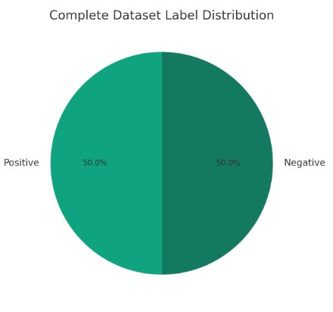
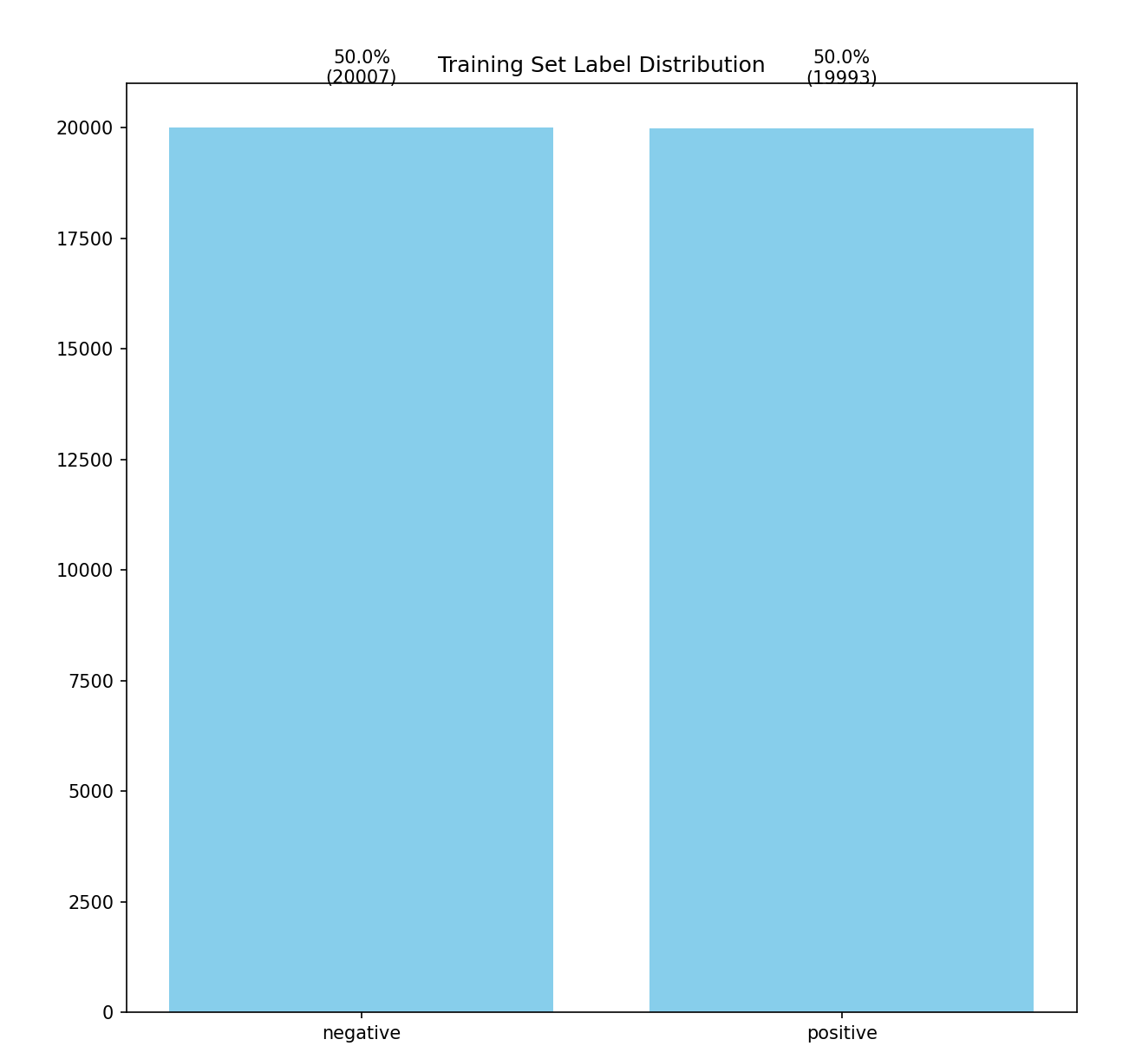
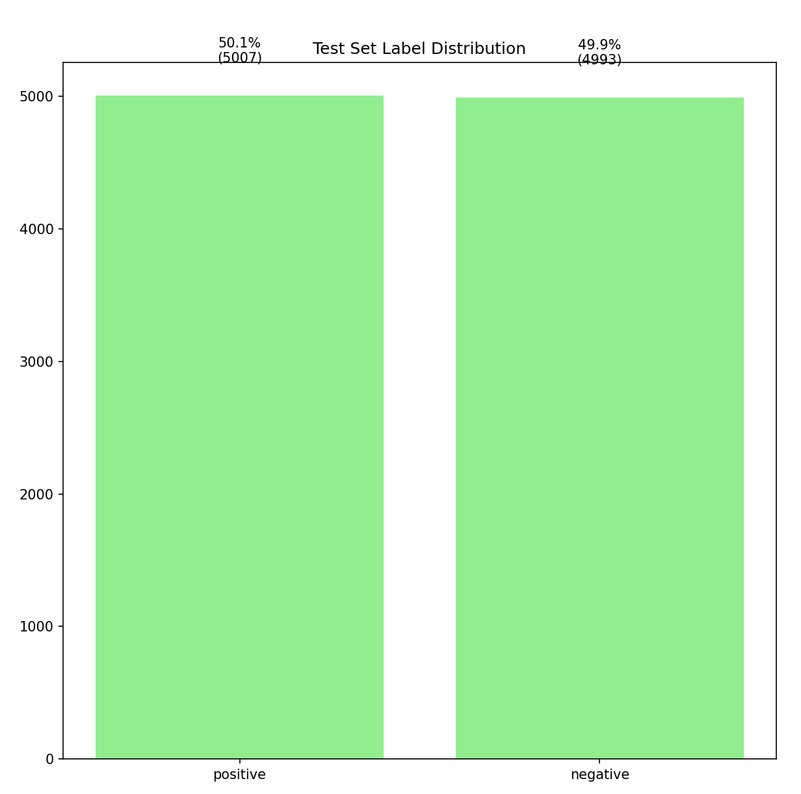
TRAINING / TEST SETS
Complete Dataset
Label Distribution
Training Set
Label Breakdown (80%)
Test Set
Label Breakdown (20%)

Slide 4
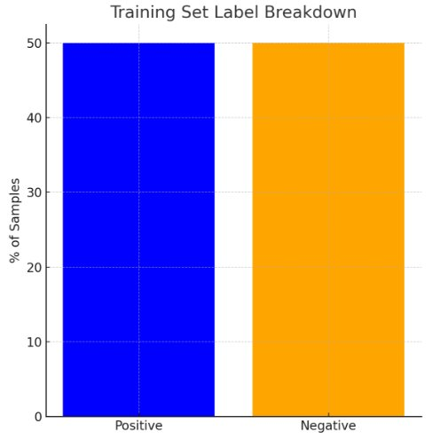
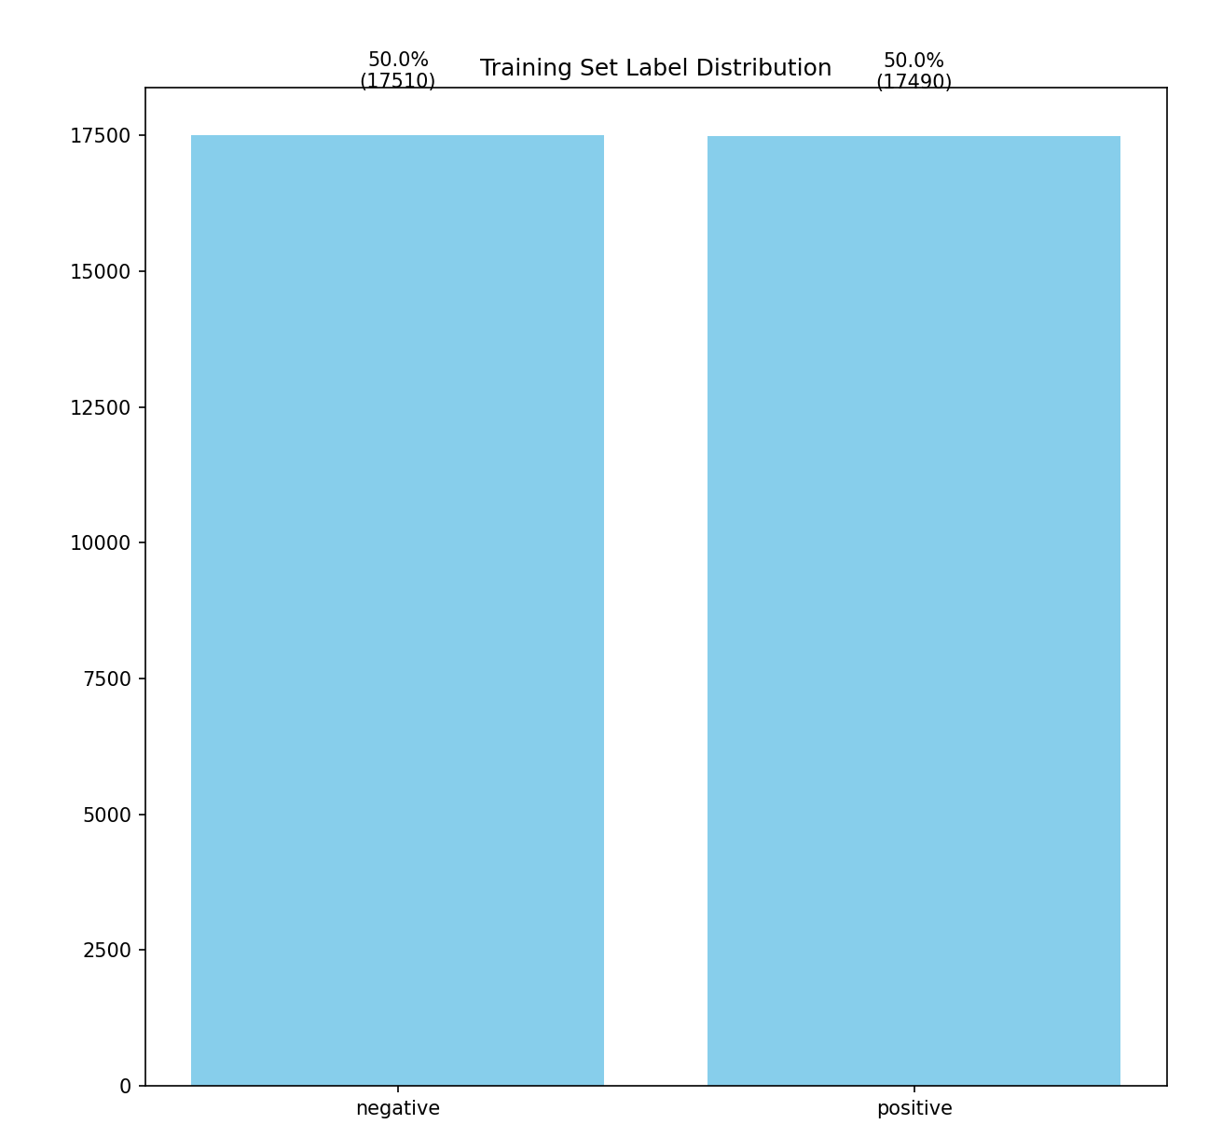

TRAINING / TEST SETS
Complete Dataset
Label Distribution
Training Set
Label Breakdown (70%)
Test Set
Label Breakdown (30%)

Slide 5
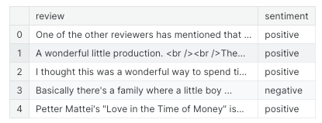
APPROACH
1. Load Dataset
Used pandas to load the IMDb dataset CSV file df = pd.read_csv('IMDB Dataset.csv')

Slide 6
APPROACH
2. Preprocess Text Data
Lowercase Conversion: Convert text to lowercase
df['review'] = df['review'].str.lower()
Remove HTML Tags: Strip HTML tags from reviews
df['review'] = df['review'].str.replace('<.*?>', '', regex=True)
Remove URLs: Remove website links
df['review'] = df['review'].str.replace('https?://\S+|www\.\S+', '', regex=True)
Remove Punctuation: Eliminate punctuation from text
Custom function remove_punc(text) using string.punctuation

Slide 7
APPROACH
Expand Chat Words: Convert chat abbreviations to full words
Custom function chat_conversion(text) with predefined chat_words dictionary
Remove Stopwords: Filter out common stop words Use nltk.corpus.stopwords
Remove Emoji: Strip emojis from text Custom function remove_emoji(text)
Tokenization and Lemmatization: Convert text into tokens and reduce them to their root form Use nltk.tokenize.word_tokenize and nltk.stem.WordNetLem matizer

Slide 8
APPROACH
3. Feature Extraction
Convert text data into a numerical format for model training -Binary Bag-of-Words Representation: Create a sparse matrix representation of the text -Custom function binary_bow_sparse(reviews, vocabulary)

Slide 9
APPROACH
4. Split Dataset into Training & Test Sets
Split based on user input percentage Use train_test_split method in concept, actual split performed manually in pseudocode
5. Train Model
Train a Naive Bayes classifier using the binary bag-of-words features Custom function train_naive_bayes(train_v ectors, train_labels, vocabulary)

Slide 10
APPROACH
6. Make Predictions and Evaluate Model
Predict sentiment labels for test data -Custom function predict(test_vector, params) for class prediction -Calculate performance metrics (accuracy, precision, recall, F1-score) Use sklearn.metrics for confusion matrix, ROC curve, etc.
7. User Interaction for Real-time Predictions
Allow users to input their own sentences for sentiment classification Custom interactive loop using input() for user sentences

Slide 11
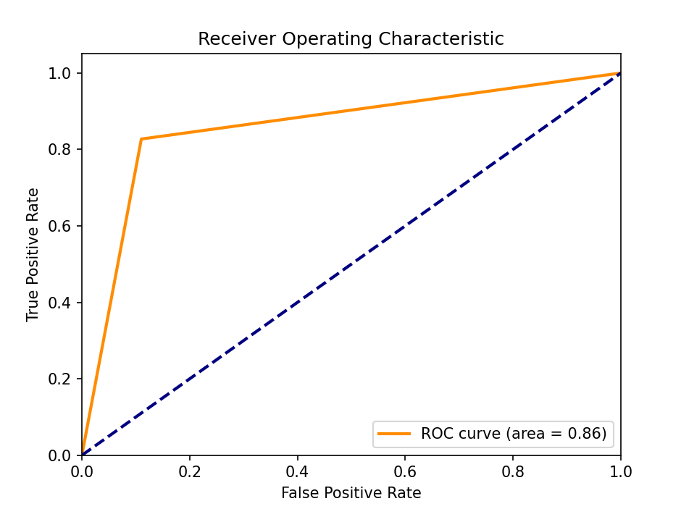
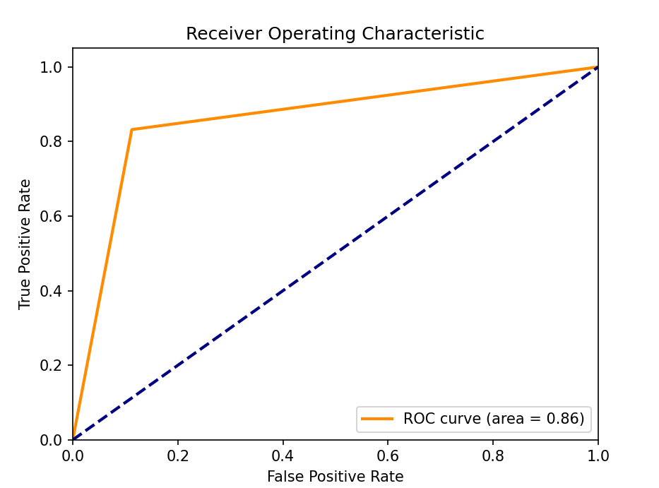
EVALUATION
ROC curve(s) for both models
Train_Size: 80
Train_Size: 70

Slide 12
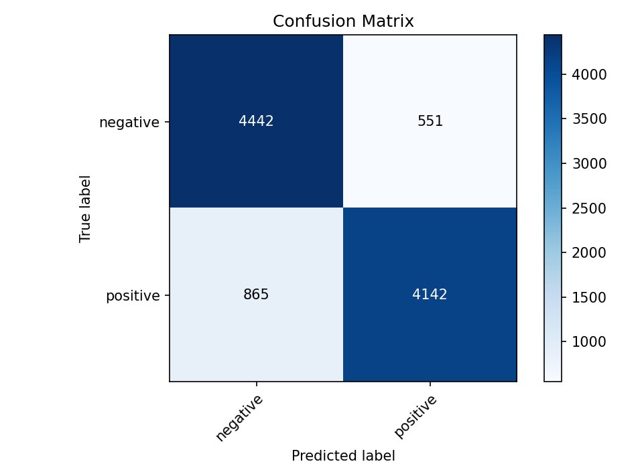

EVALUATION
Confusion matrices for both models
Train_Size: 80
Train_Size: 70

Slide 13
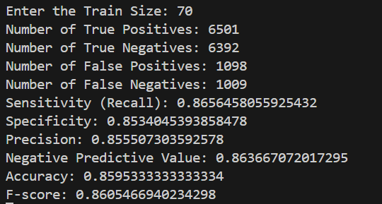
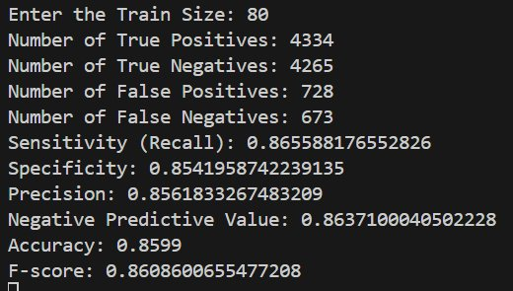
SUMMARY
The model demonstrates a good overall accuracy of 85.99%, with high sensitivity and specificity indicating its effectiveness at identifying both positive and negative reviews. Precision is slightly lower, suggesting occasional false positives, but the high negative predictive value and F-score reflect a well-balanced classification performance.a​
Output

